Slide 1
How to globally update the status of inactive users to active
Yoel Kortick
Senior Librarian
January 2025

Slide 2
Agenda
Introduction
Our sample set
Globally updating the Status
Check the results of the job
2

Slide 3
Introduction

Slide 4
Introduction
In this presentation we will globally change the status of Inactive users to Active.
We will assume that the set of users already exists.
For information on how to create a set of users using Alma Analytics see the following examples:
  How to create a set in Alma (using Alma Analytics) of all users that have an item on loan.pptx
  How to create a set in Alma (using Alma Analytics) of all users that have an expiration date in the past.pptx
For information on how to create a set of users in Alma see:
  Creating Itemized Sets
  User Sets

Slide 5
Our sample set

Slide 6
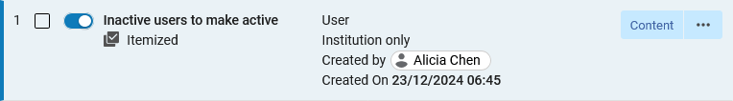
Our sample set
We have a set named “Inactive users to make active”

Slide 7
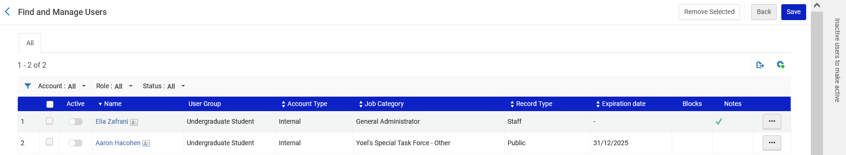
Our sample set
The set named “Inactive users to make active” has two users, each of whom is inactive

Slide 8
Globally updating the Status

Slide 9

Globally updating the Status
Now we will run the job “Update/Notify Users”.
We will access the job via “Admin > Manage Jobs and Sets > Run a Job”:

Slide 10
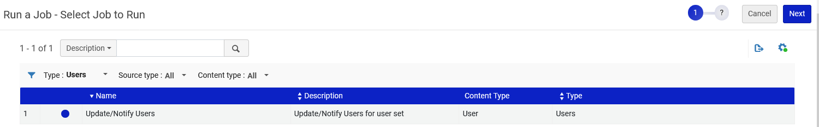
Globally updating the Status
Now we will run the job “Update/Notify Users”

Slide 11
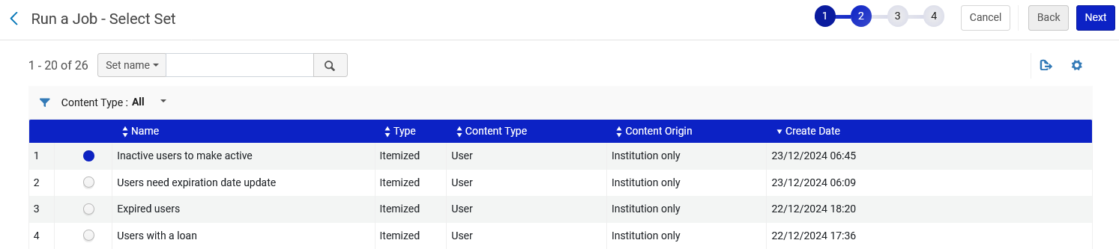
Globally updating the Status
We will choose the set we just looked at

Slide 12
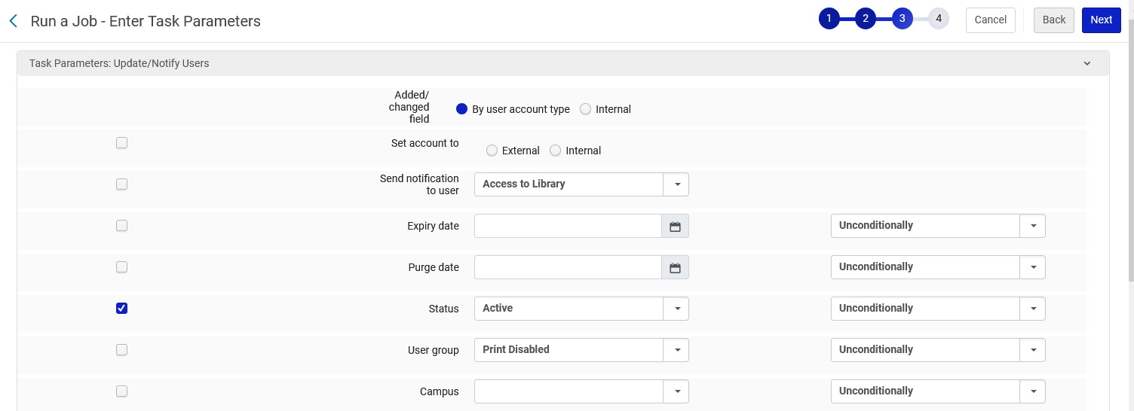
Globally updating the Status
We will set the users as active

Slide 13
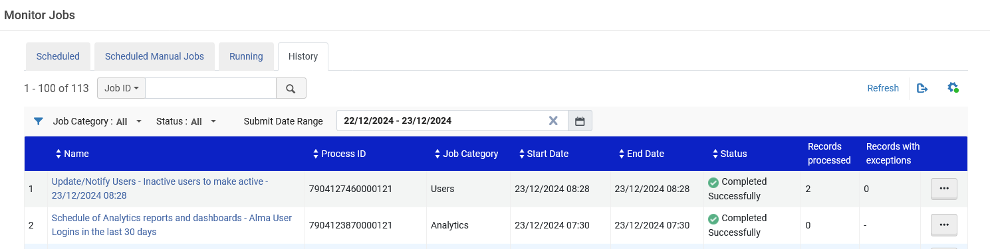
Globally updating the Status
The job completes

Slide 14
Check the results of the job

Slide 15
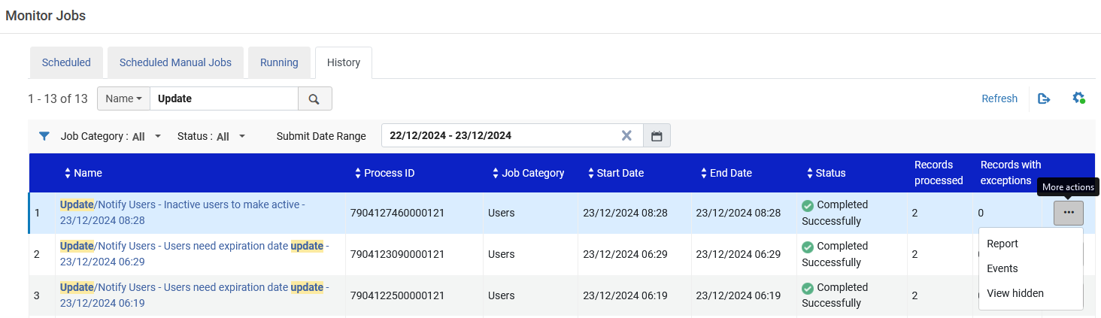
Check the results of the job
Let’s look at the job report.

Slide 16
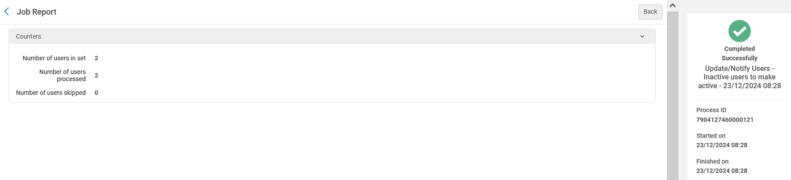
Check the results of the job
It states that two users were in the set and two users were processed

Slide 17
Check the results of the job
Let’s again look at the contents of the set

Slide 18
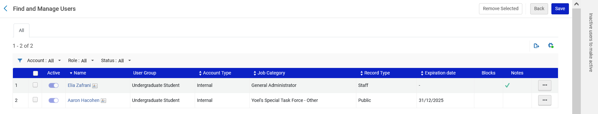
Check the results of the job
We see that both users are now active. The global update to the entities in the set was successful.

